Slide 1



Funding in Startups
Presentation

Slide 2
Exploratory Data Analysis and Hypothesis Testing of Startup Funding Dataset
Objective
Key Focus Areas
Tools Used
To analyze patterns and relationships in startup funding data.
To explore how factors such as market categories, geographical regions, and founding dates influence the total funding startups receive.
To use statistical hypothesis testing to validate insights about the startup ecosystem.
Distribution of funding across categories and geographies.
Timing of funding rounds and its impact on funding success.
Testing hypotheses around market categories, geographical regions, and funding timing.
Python
(Numpy, Pandas, Seaborn, Matplotlib, Scipy)
Visualizations
Correlation Analysis
Statistical Tests
(ANOVA, T-Test)

Slide 3
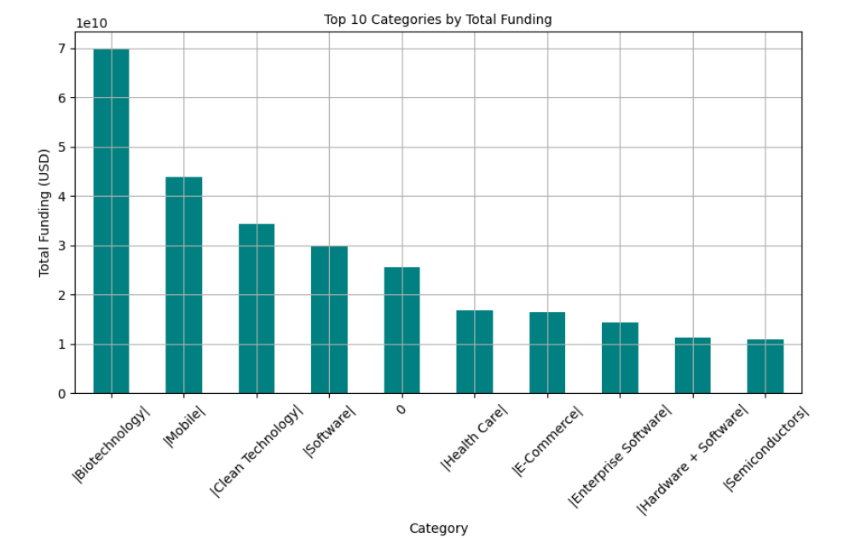
Understanding the Distribution of Funding by Market Categories
Key Observation:
The ANOVA test revealed that the mean funding varies significantly across market categories (p < 0.05).
Some categories (e.g.,Biotechnology, Saas , FinTech) attract substantially more investment than others.
Implications:
Startups: Market category plays a key role in funding potential, with certain categories enjoying more capital flow.
Investors: Should focus on high-growth sectors, but also consider emerging categories with untapped potential.

Slide 4
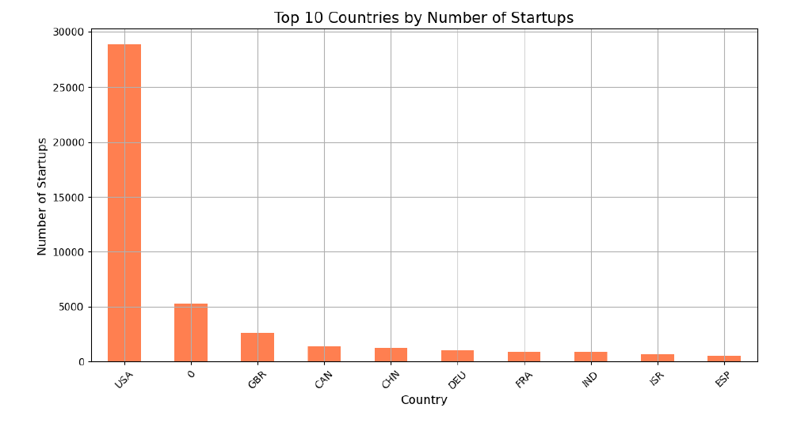
Geographical Impacts & Insights on Startup Funding
Key Observation:
T-Test results showed significant differences in funding between countries (e.g., USA vs. Canada) (p < 0.05).
USA leads in total funding, with Canada and UK attracting significantly lower investments.
Implications:
Startups in Low-Funding Regions: Must seek alternative funding sources or expand into high-funding markets.
Investors: While the USA dominates, there could be high-value opportunities in emerging markets at lower competition.

Slide 5
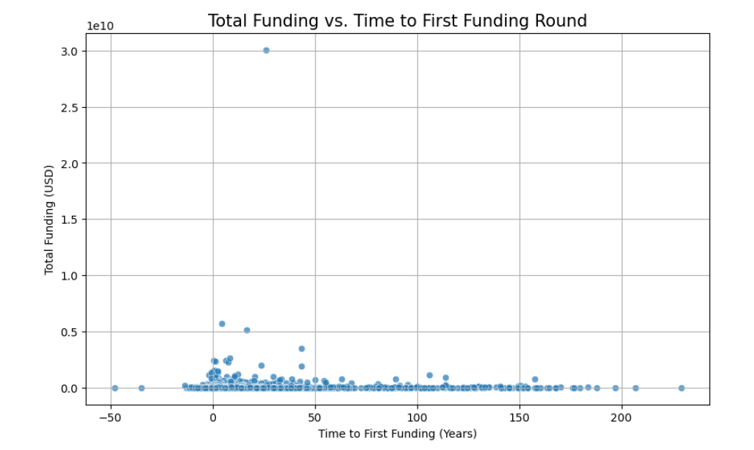
Correlation Analysis: Impact of Founding Year on Funding Success
Key Observation:
Correlation analysis found a significant relationship between the year a startup was founded and its total funding.
Startups founded in earlier years tend to attract higher total funding, possibly due to longer market presence and more funding rounds.
Implications:
Startups: Early entry into the market can lead to cumulative funding advantages.
Investors: Could focus on established startups with a history of growth, but should also seek new entrants with unique innovations.

Slide 6
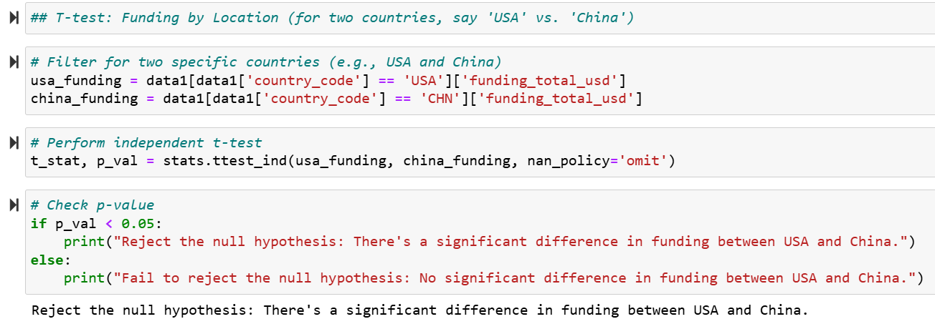
Hypothesis Testing: Funding Differences Across Market Categories & Regions
Key Observation:
Hypothesis: Geographical location significantly impacts the amount of funding startups receive.
Test Applied: t-Test between countries (e.g., USA vs. China) shows significant differences in mean funding levels (p < 0.05).
Implications:
Startups: Should consider geography as a key factor in fundraising strategies.
Investors: Location matters, with the USA being a funding hub, though emerging markets offer untapped potential.

Slide 7
Recommendation to the Business Stakeholders:
Diversify Investments: While investing in established high-growth categories is important, there is also an opportunity to invest early in emerging markets before they become saturated. This can lead to higher potential returns. Keep an Eye on Emerging Sectors: Consider sectors with increasing traction, as they may provide early opportunities for high returns when the market matures. | Focus on High-Funding Regions: Regions like Silicon Valley and New York have established ecosystems, making them strong candidates for continued investment. Explore Emerging Markets: Investing in underfunded regions can present opportunities for finding undervalued startups that face less competition, often at more favorable valuations. | First-Mover Advantage: Investing in startups during their early rounds can be advantageous, as startups that secure early funding often continue to attract capital. Investors should look for early-stage startups with a solid business model and potential for scalability. Monitor Progression: Keep track of how startups move through funding rounds and consider following up with further investments as the company progresses.
Established Startups: Investing in older, established startups can offer more stability, especially if they’ve shown the ability to scale and grow over time. New Entrants: However, newer startups with disruptive innovations may offer unique opportunities for higher returns, especially in markets with increasing demand. | Leverage Data for Investment Decisions: Investors should use the insights from hypothesis tests to better understand funding trends and identify which sectors and regions are most likely to yield high returns. Allocate Capital Efficiently: Focus on categories and regions that align with historical success while being open to emerging opportunities highlighted by the data. | Balance Early-Stage and Late-Stage Investments: Consider maintaining a portfolio of both early-stage and growth-stage investments to optimize returns and balance risk.

Slide 8
Conclusion and Key Takeaways:
Key Insights:
Strategic Implications:
Future Work:
Market Category: Significantly influences funding, with some categories receiving more capital than others.
Geography: Funding varies greatly by location, with regions like the USA dominating.
Founding Year: Early-stage startups tend to accumulate more funding over time.
For Startups: Choose market categories wisely and consider location for funding opportunities.
For Investors: Focus on high-growth markets, but explore emerging opportunities for lower competition.
Further analysis on more granular geographical regions.
Investigation into other factors like team composition or product focus for their impact on funding.

Slide 9

"Invest in the vision, not just the venture. The greatest returns come not from chasing trends, but from nurturing ideas that shape the future."

Slide 10



